Slide 1
Marketing Analysis among financial institutions
By:
Sukhveer Singh,
Deep Shah,
Jefrine Rex Anto,
Devanshu Akhilkumar Chokhani

Slide 2
Background:
Due to the increase of marketing campaigns, it is important to forecast the suitable advertising strategy that targets the appropriate demographic.
As of January 12th, 2021, according to Wikipedia. The sole reason that 97.4% of the products are being sold is because of financial institutions' marketing initiatives.
The budget and duration of the campaign should be estimated in accordance with the different campaign types using an interactive dashboard.

Slide 3
About the dataset:
We have used “Bank Marketing Dataset” from UCI Machine Learning Dataset.
The data is related with direct marketing campaigns of a Portuguese banking institution.
The marketing campaigns were based on phone calls. Often, more than one contact to the same client was required, in order to access if the product (bank term deposit) would be (or not) subscribed.

Slide 4
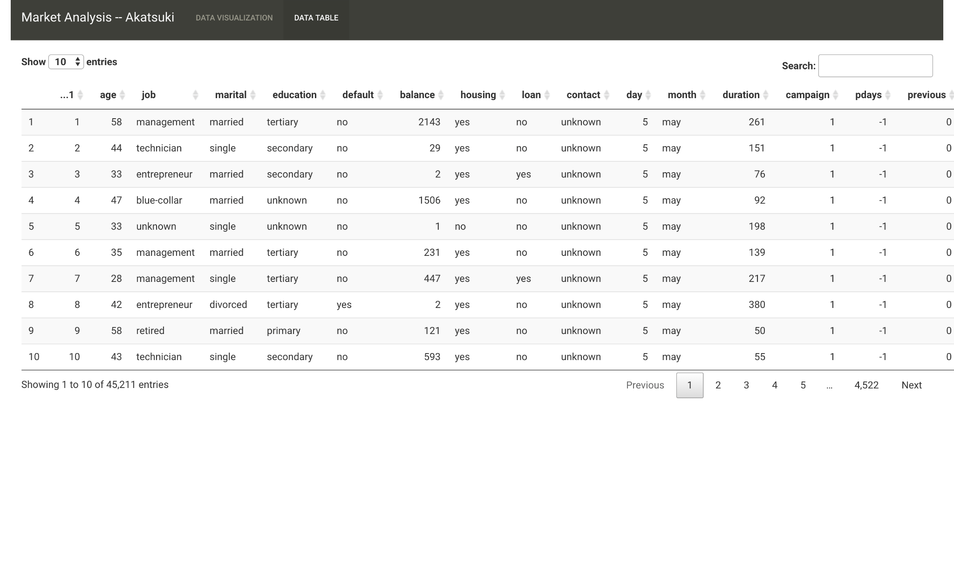
Link for the dataset: BANK MARKETING DATASET

Slide 5
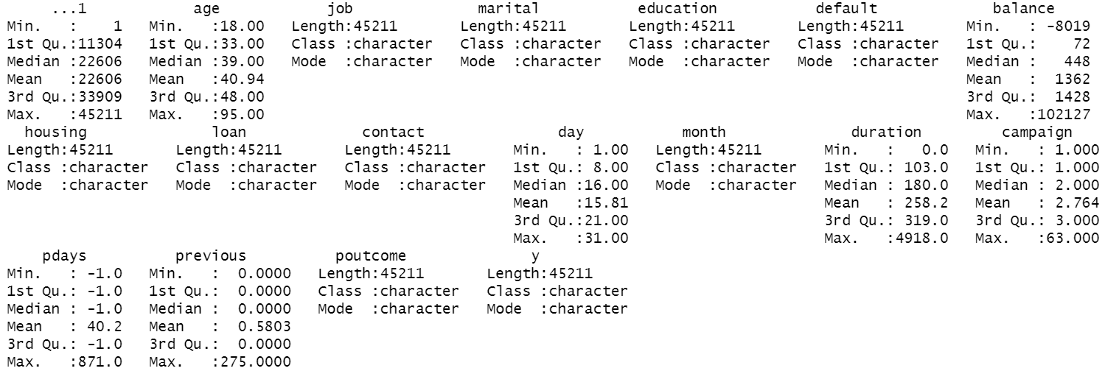
Data Description

Slide 6
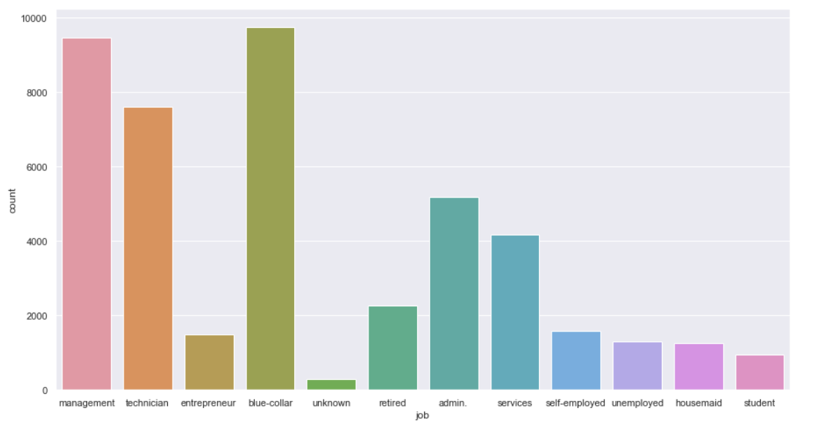
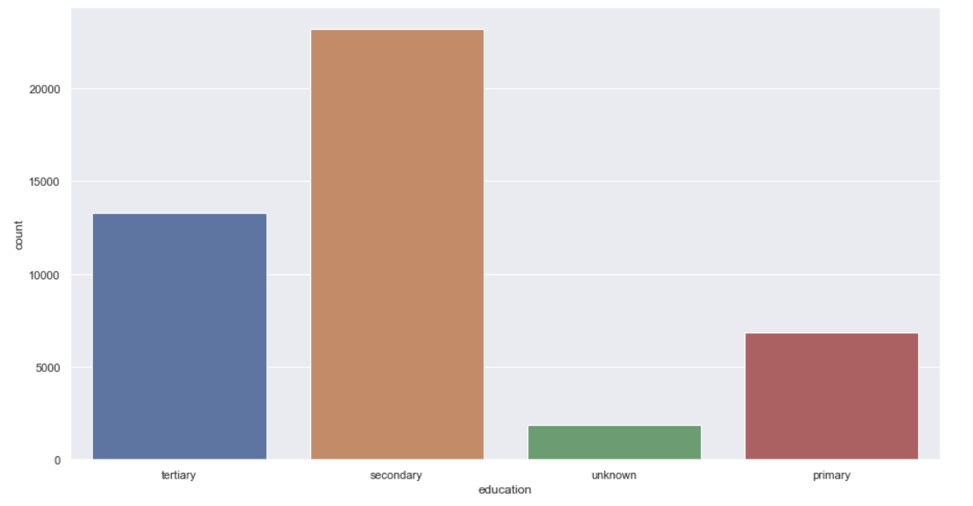
EDA
JOB
EDUCATION
There are 12 unique Job values, 4 unique education values and 3 martial values

Slide 7
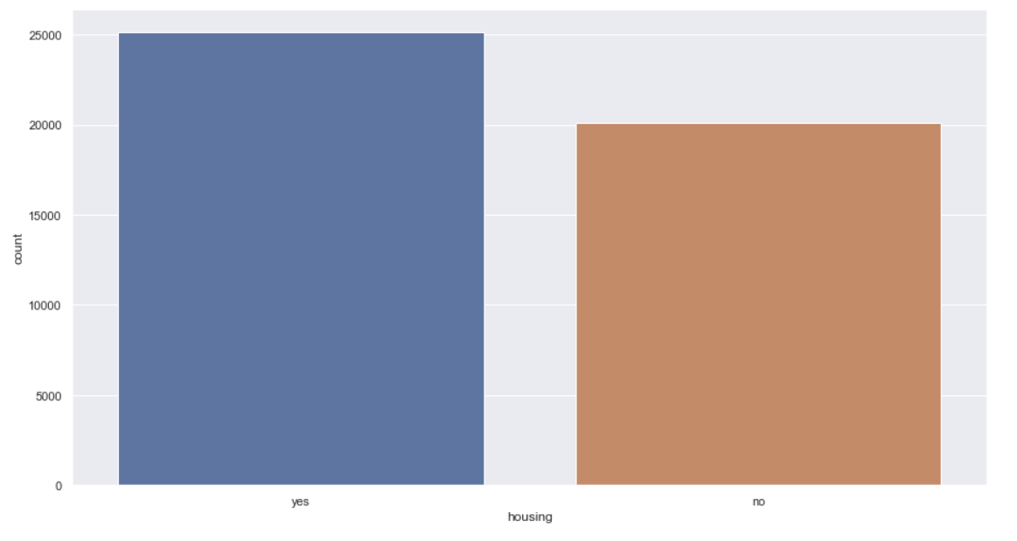
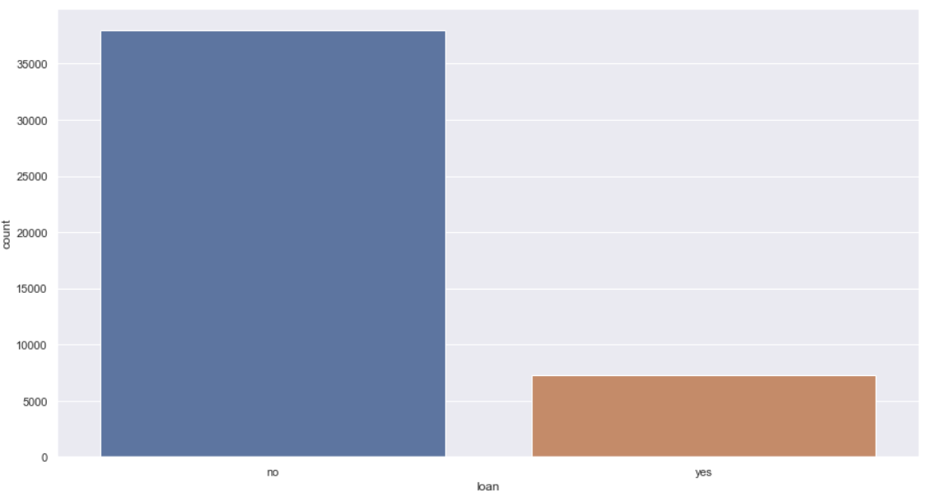
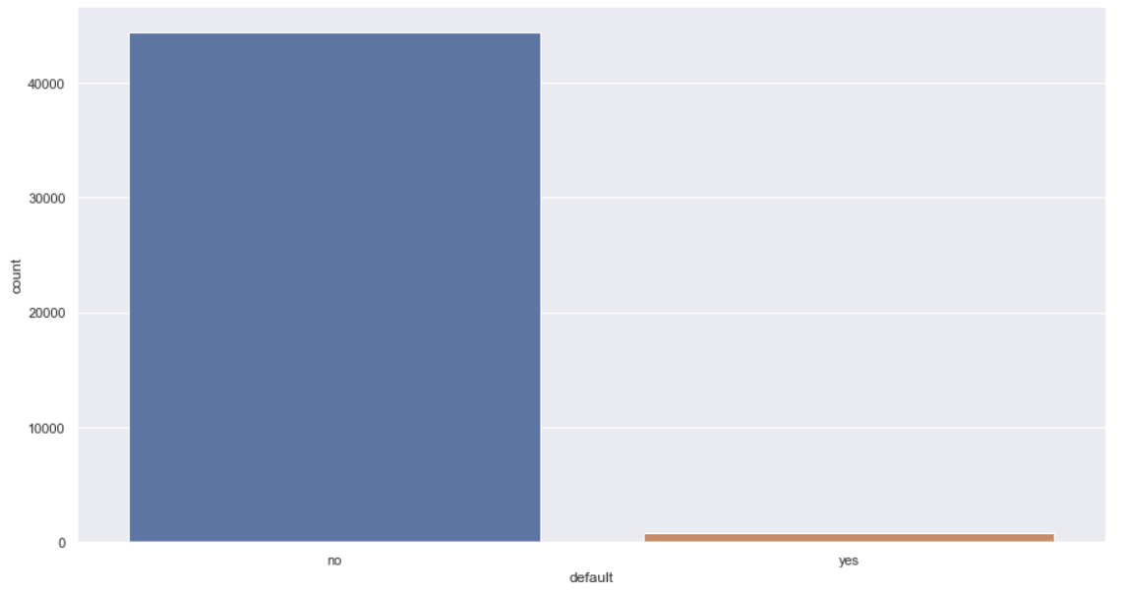
Binary Attributes
HOUSING
LOAN
DEFAULT

Slide 8
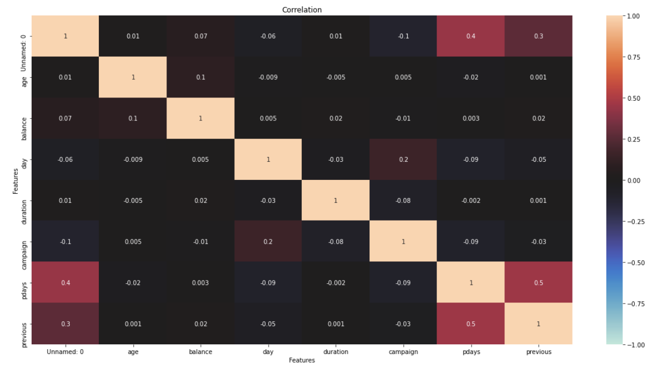
Correlation heatmap

Slide 9
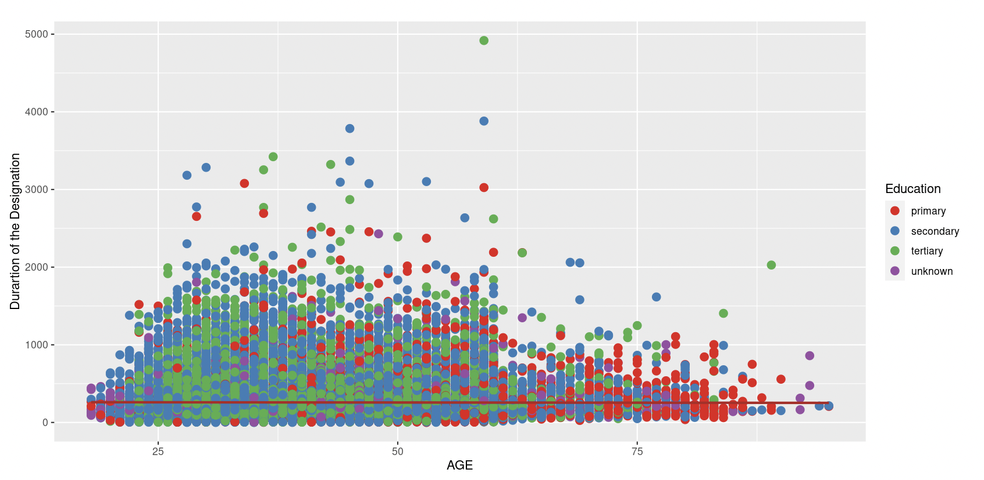
Employee with suitable experience and training

Slide 10
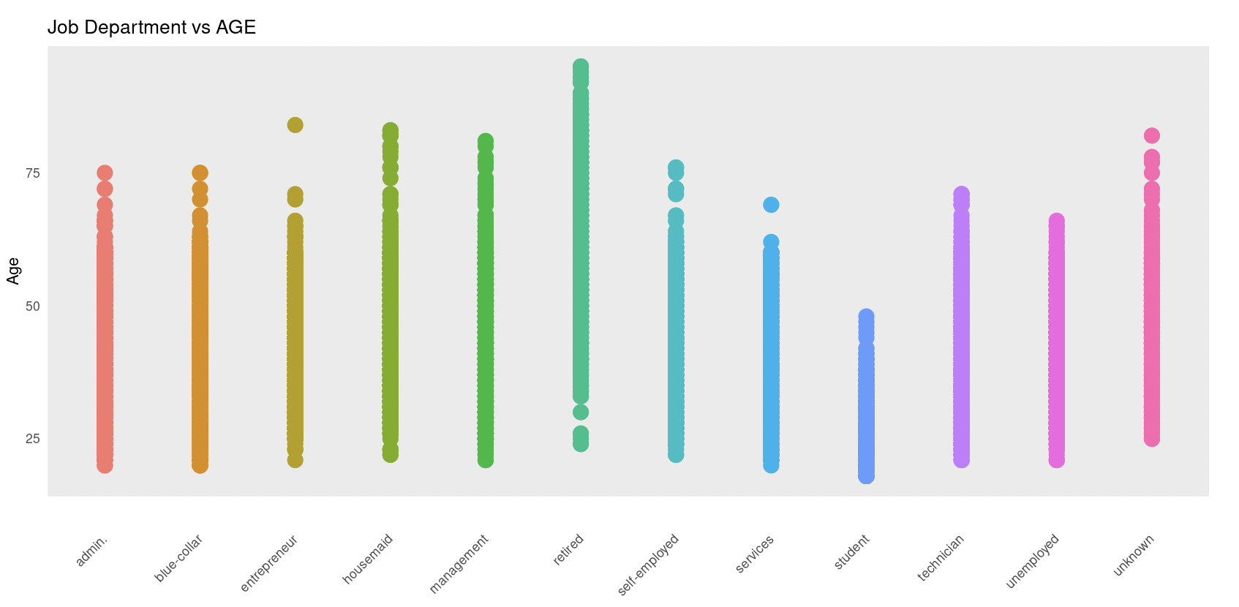

Slide 11
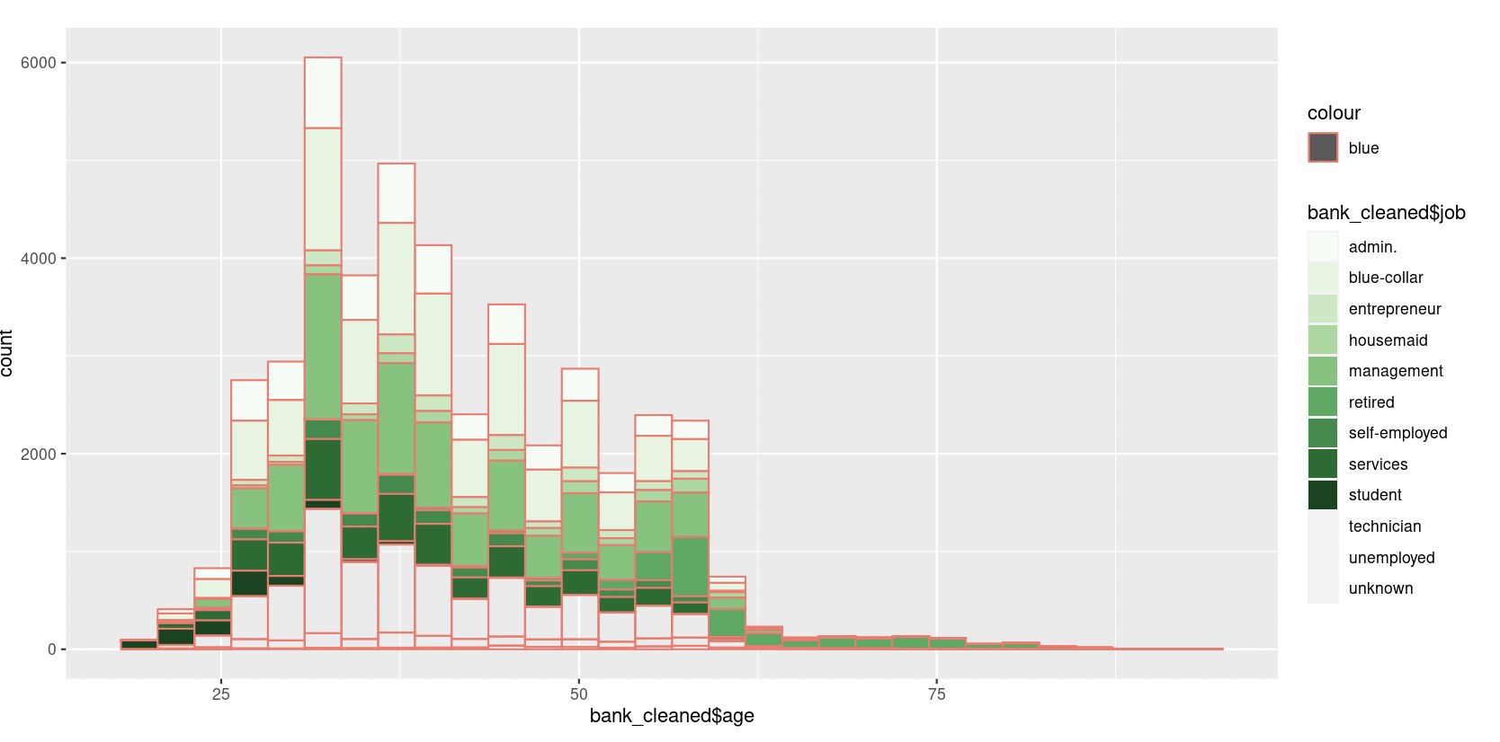
Senior staff in the investment industry

Slide 12
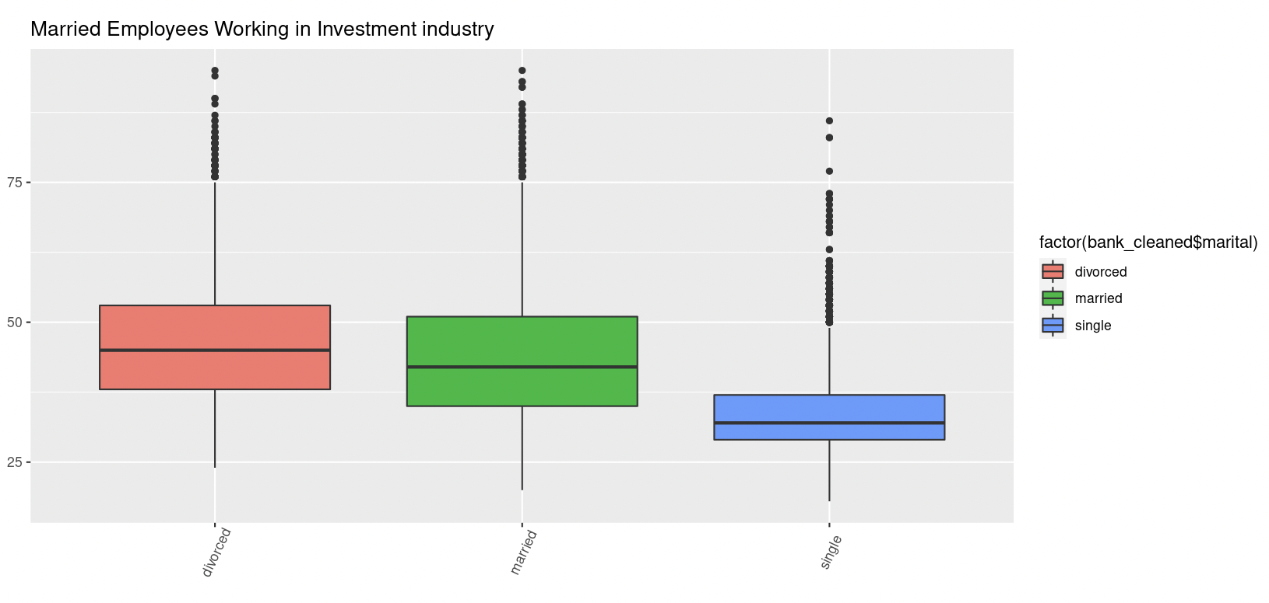

Slide 13
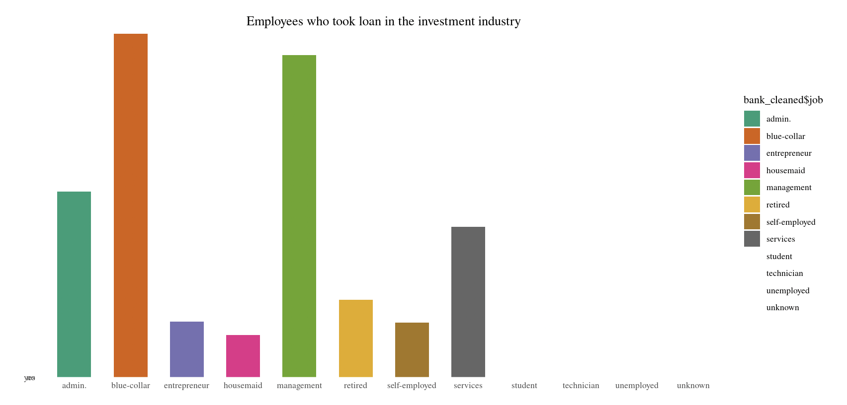

Slide 14
Conclusion and Scope
On processing the data, we came to the following conclusion:
The employees who had primary education have been employed for a longer duration as compared to the rest.
There are a very few number of people who turning into entrepreneurs after crossing 75 years of age.
Surprisingly, housemaids have been working for a longer period of time in this sector.
FUTURE SCOPE : This dataset can be used for bank marketing campaigns and accordingly target customers based on type of education, marital status and various other attributes.

